Slide 1
Estimated Glomerular Filtration Rate
Greg Miller, PhD
Professor of Pathology
Virginia Commonwealth University Health System
Richmond, Virginia, USA
greg.miller@vcuhealth.org
AACC NE Section Meeting, February 17, 2022

Slide 2
Financial disclosures:
Siemens Healthineers, speaking honorarium

Slide 3
Topics
Estimating GFR, historical perspective
Racial disparity in medicine; eliminate the race coefficient
An evidence based systematic approach
Implementing the NKF/ASN 2021 recommendations

Slide 4
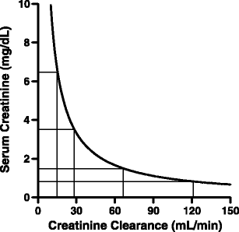
Pre 1970

Slide 5
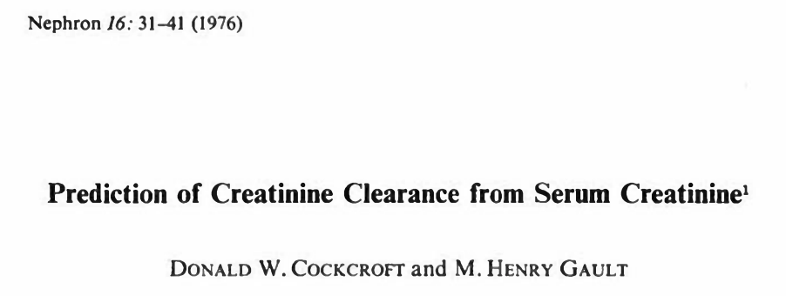
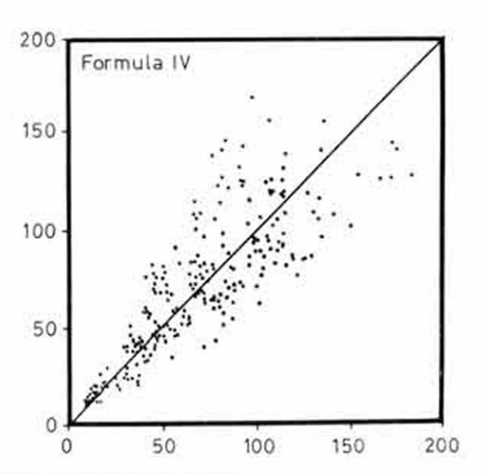
Calculated, mL/min
249 males
Creatinine method not stated
Jelliffe RW. Lancet 1971 May 8;1(7706):975-6.
Jadrny L. Cas. Lek. ces. 1965, 104, 947
Effersoe P. Acta med. scand. 1957, 156, 429
Measured, mL/min

Slide 6
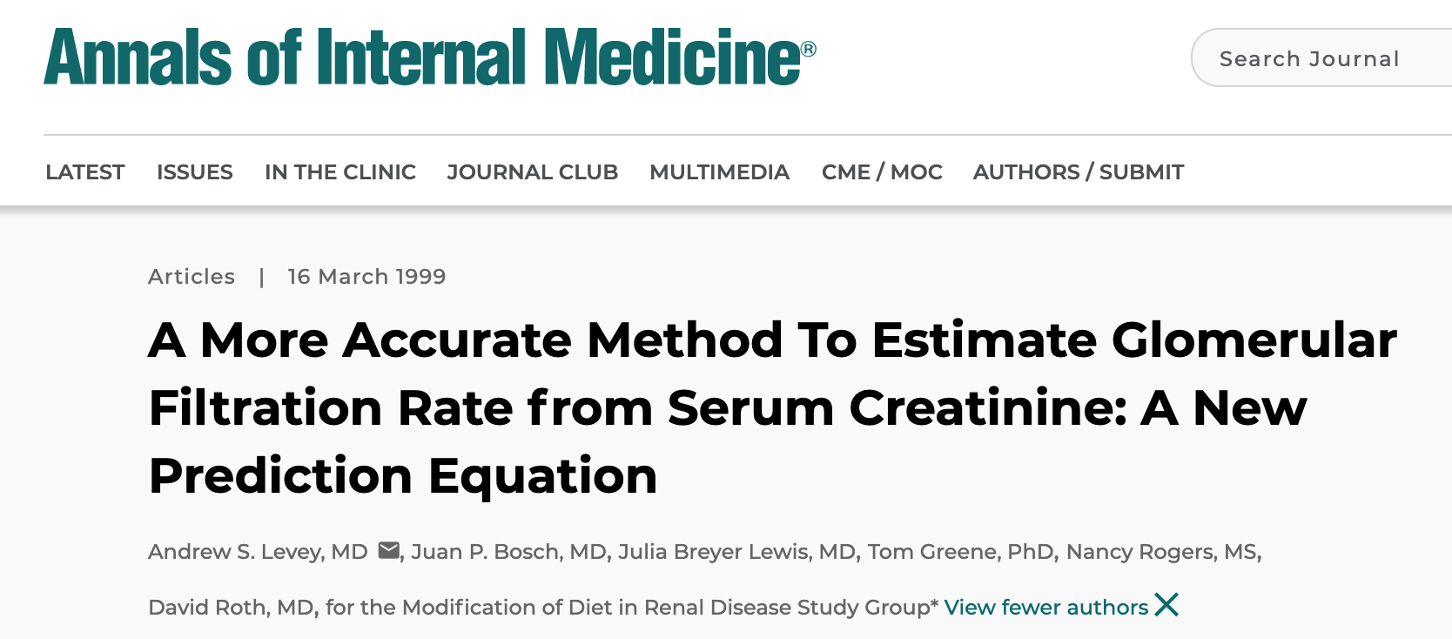

Slide 7
Patients with eGFR 30-59 mL/min/1.73m² who were aware of the condition.
NHANES 1999-2000
Coresh, et al. J Am Soc Nephrol 2005;16:180-188.

Slide 8
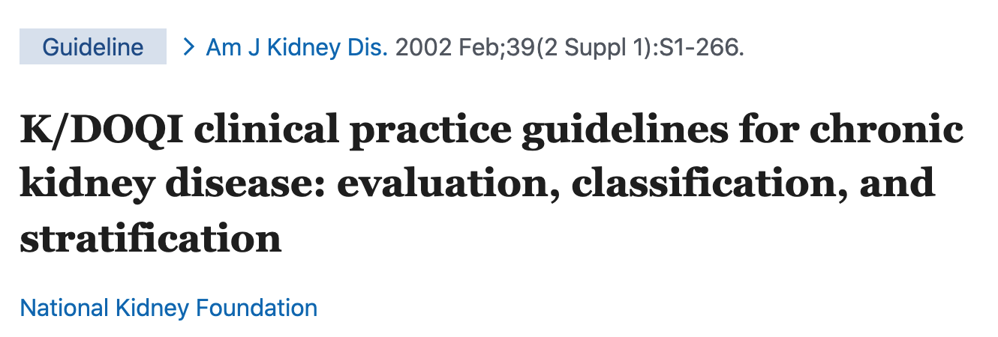
5 stages/classifications of CKD based on GFR
Recommended that labs report eGFR from creatinine using the MDRD Study 1999 equation

Slide 9

NKF/NKDEP: we need your help to get labs to report eGFR
CAP: sure, did you know creatinine is not standardized?

Slide 10
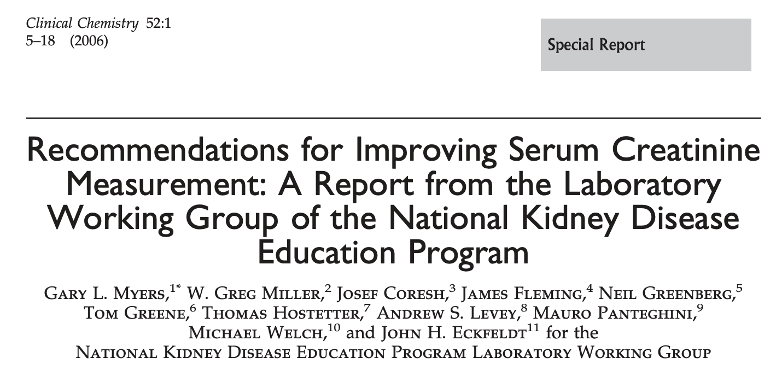

Slide 11
Recommendations
Report eGFR with all creatinine results for adults
  eGFR if African American
  eGFR if not African-American
Use a creatinine measurement procedure with calibration standardized (traceable) to IDMS
Myers et al. Clin Chem 2006;52:5-18

Slide 12
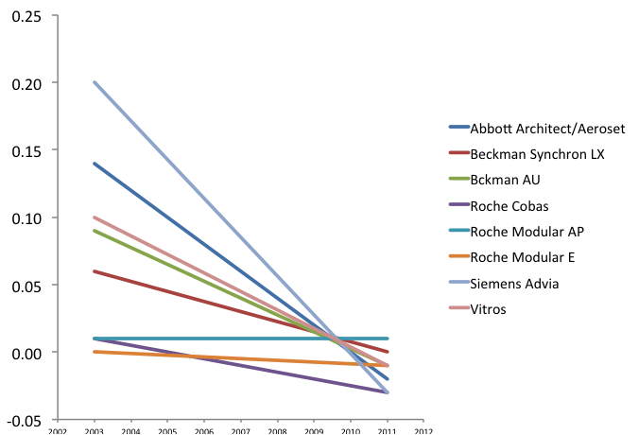
Creatinine calibration is now standardized for measurement procedures from large global IVD manufacturers
Bias vs. IDMS at 0.9 (2003) and 0.8 (2011) mg/dL
[80 (2003) and 71 (2011) µmol/L]
2003 2011
Adapted from a table in: Killeen et al. Arch Pathol Lab Med 2013;137:496-502.

Slide 13
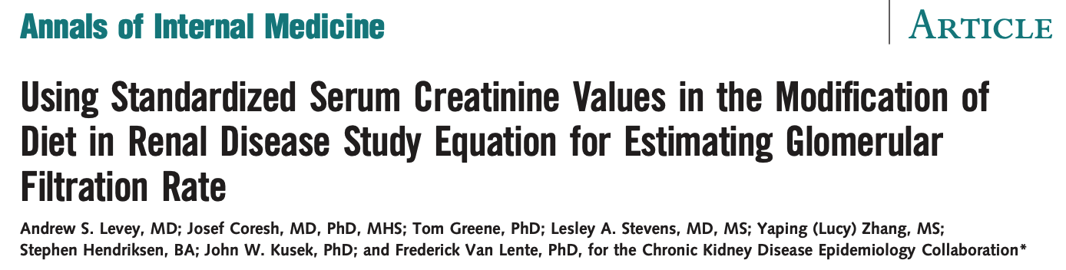
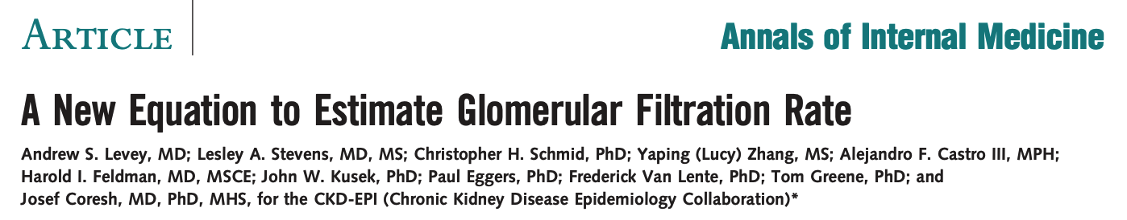
2006;145:247-54
CKD-EPI improved the accuracy of MDRD
2009;150:604-12

Slide 14
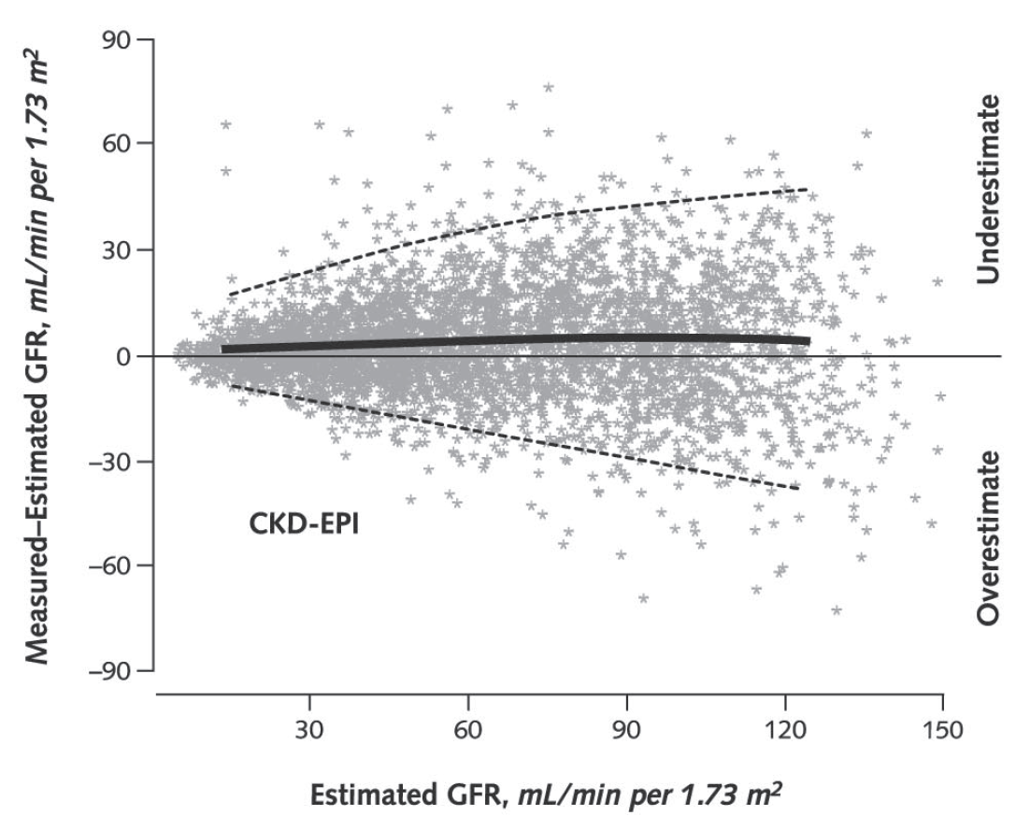
Uncertainty in eGFRcr, CKD-EPI 2009
P-30 = 84% of eGFR were within 30% of mGFR
Dashed lines are 95% CI for the difference mGFR-eGFR
Levey, et al. Ann Intern Med 2009; 150: 604-12.

Slide 15
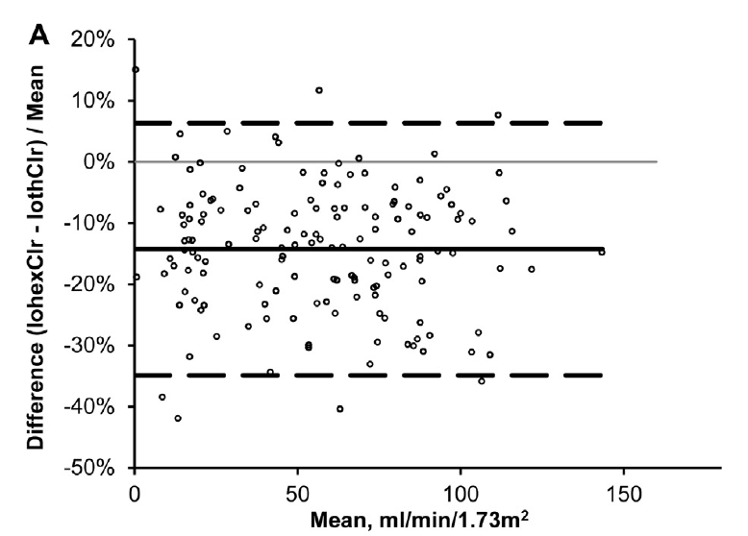
How good is measured GFR
CKD-EPI used mGFR iothalamate
Assuming mGFR iothalamate is correct:
P30 = 100%
P10 = 95%
Seegmiller et al. Am J Kidney Dis 2016;67:49-55

Slide 16
Labs reporting eGFR (adults)
College of American Pathologists; https://documents.cap.org/documents/2020-a-kidney-biomarkers.pdf

Slide 17
Equations used for eGFR in 2019
20% using equations for non-IDMS traceable creatinine
College of American Pathologists; https://documents.cap.org/documents/2020-a-kidney-biomarkers.pdf

Slide 18
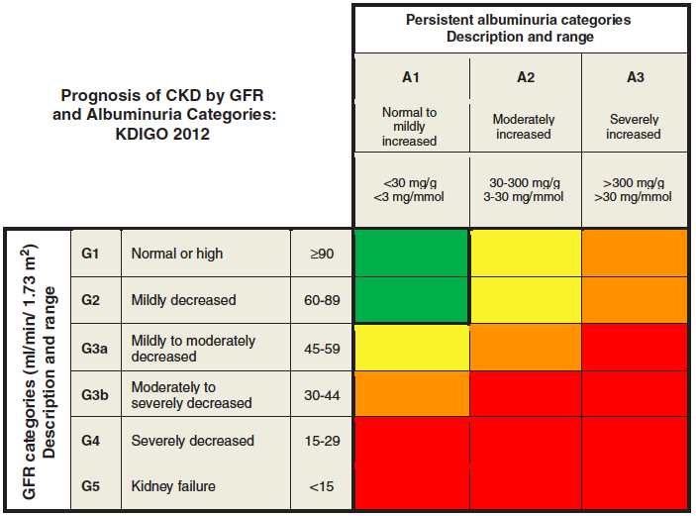
KDIGO 2012 Clinical Practice Guideline for the Evaluation and Management of Chronic Kidney Disease
eGFR from Cystatin C
recommended here
or when eGFRcr compromised
Kidney Inter Suppl. 2013; 3: 1–150

Slide 19
Cystatin C in 3900 US labs in 2020
2% offered cystatin C in their laboratories
90% sent specimens to a referral laboratory
8% did not answer the question
My lab offers Cystatin C in-house
Cystatin C is ordered for 0.6% of creatinine orders
College of American Pathologists, 2020-A Chemistry Survey. https://documents.cap.org/documents/2020-a-kidney-biomarkers.pdf

Slide 20
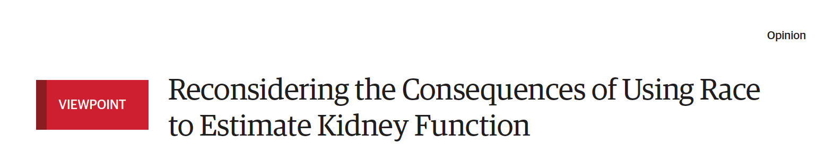
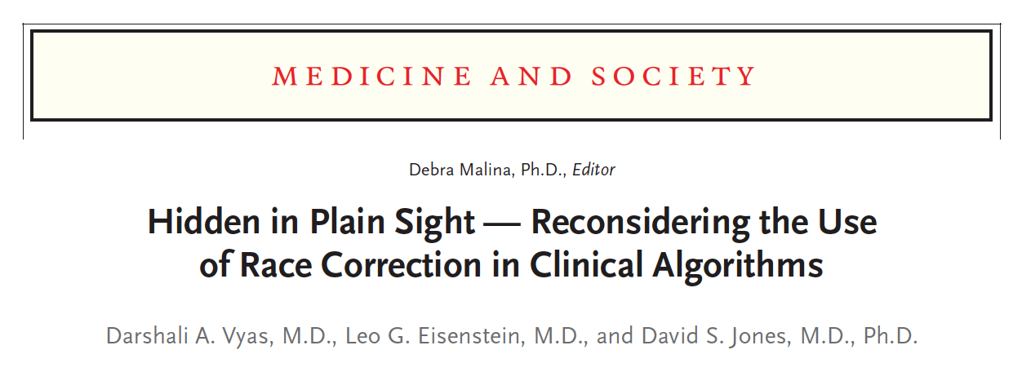
Eneanya, et al. JAMA 2019;332:113-4.
NEJM 2020; 383:874-882.

Slide 21
Observations
Race is a social, not biological, construct
Black people develop CKD 3.5x more than non-Hispanic White people
Black people have 7.6% lifetime risk for ESKD vs. 1.7% for non-Hispanic White people
Black people are 2x less likely to receive a living donor kidney transplant
Black people spend 2x longer on dialysis waiting for a deceased donor kidney transplant
Ojo. Ann Intern Med 2022; doi:10.7326/M21-4875

Slide 22

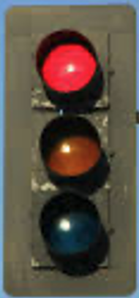
CKD-EPI 2009 eGFRcr equation
16% higher eGFR for Black people at the same creatinine concentration
Why?
More accurate fit to measured GFR in the development data set
(31.5% Black of 8254 people)
If the 16% was removed, eGFR would be lower for Blacks and thus:
  Earlier referral for kidney care
  Earlier eligibility for kidney transplant
  Decrease eligibility for nephrotoxic drugs
  Treat people with drugs before they need it

Slide 23
Was the data for Blacks representative of the US population in the CKD-EPI 2009 development data set?
  High percent were from lower socio-economic conditions that affects occupation, diet, environmental influences, access to medical care, etc.
  The equation without the Black term is more accurate in Black populations in other countries
For more details see:
Levey et al. CJASN 2020;15:1203-12
Eneanya et al. Nat Rev Nephrol 2022;18:84-94

Slide 24
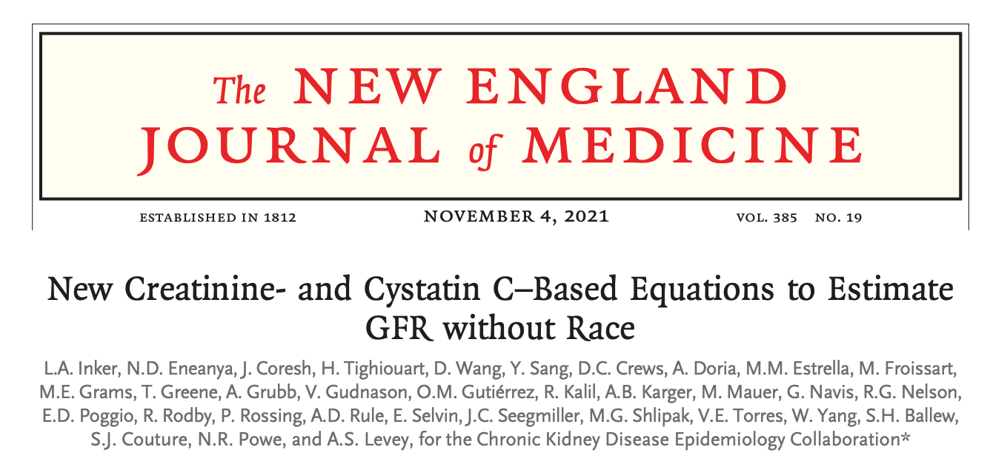
Online September 23, 2021

Slide 25
CKD-EPI 2021 eGFRcr and eGFRcr-cys equations
Refit without using race as a modifier
Equations have the same parameters as previous with different coefficients and no race term
eGFRcr used the same development data set as in 2009 (8254 people, 31.5% Black)
eGFRcr-cys used the same development data set as in 2012 (5352 people, 39.7% Black)
Equations were validated using a new data set (4050 people, 14.3% Black)

Slide 26
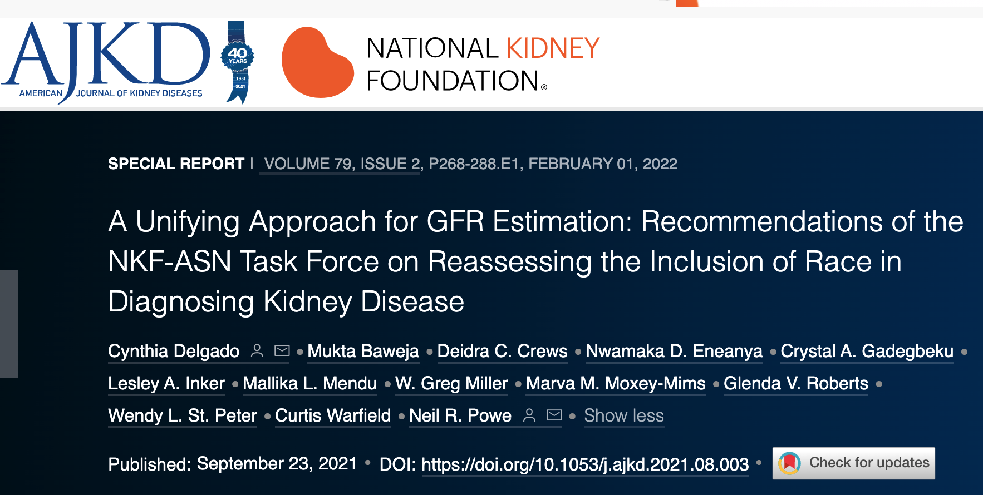
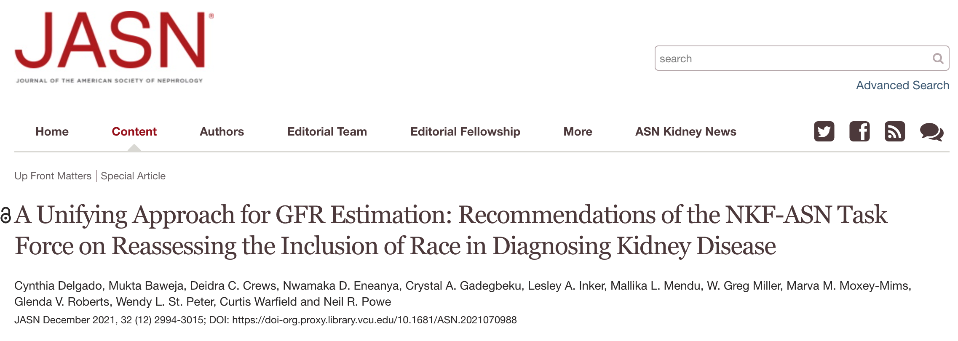
Online September 23, 2021

Slide 27
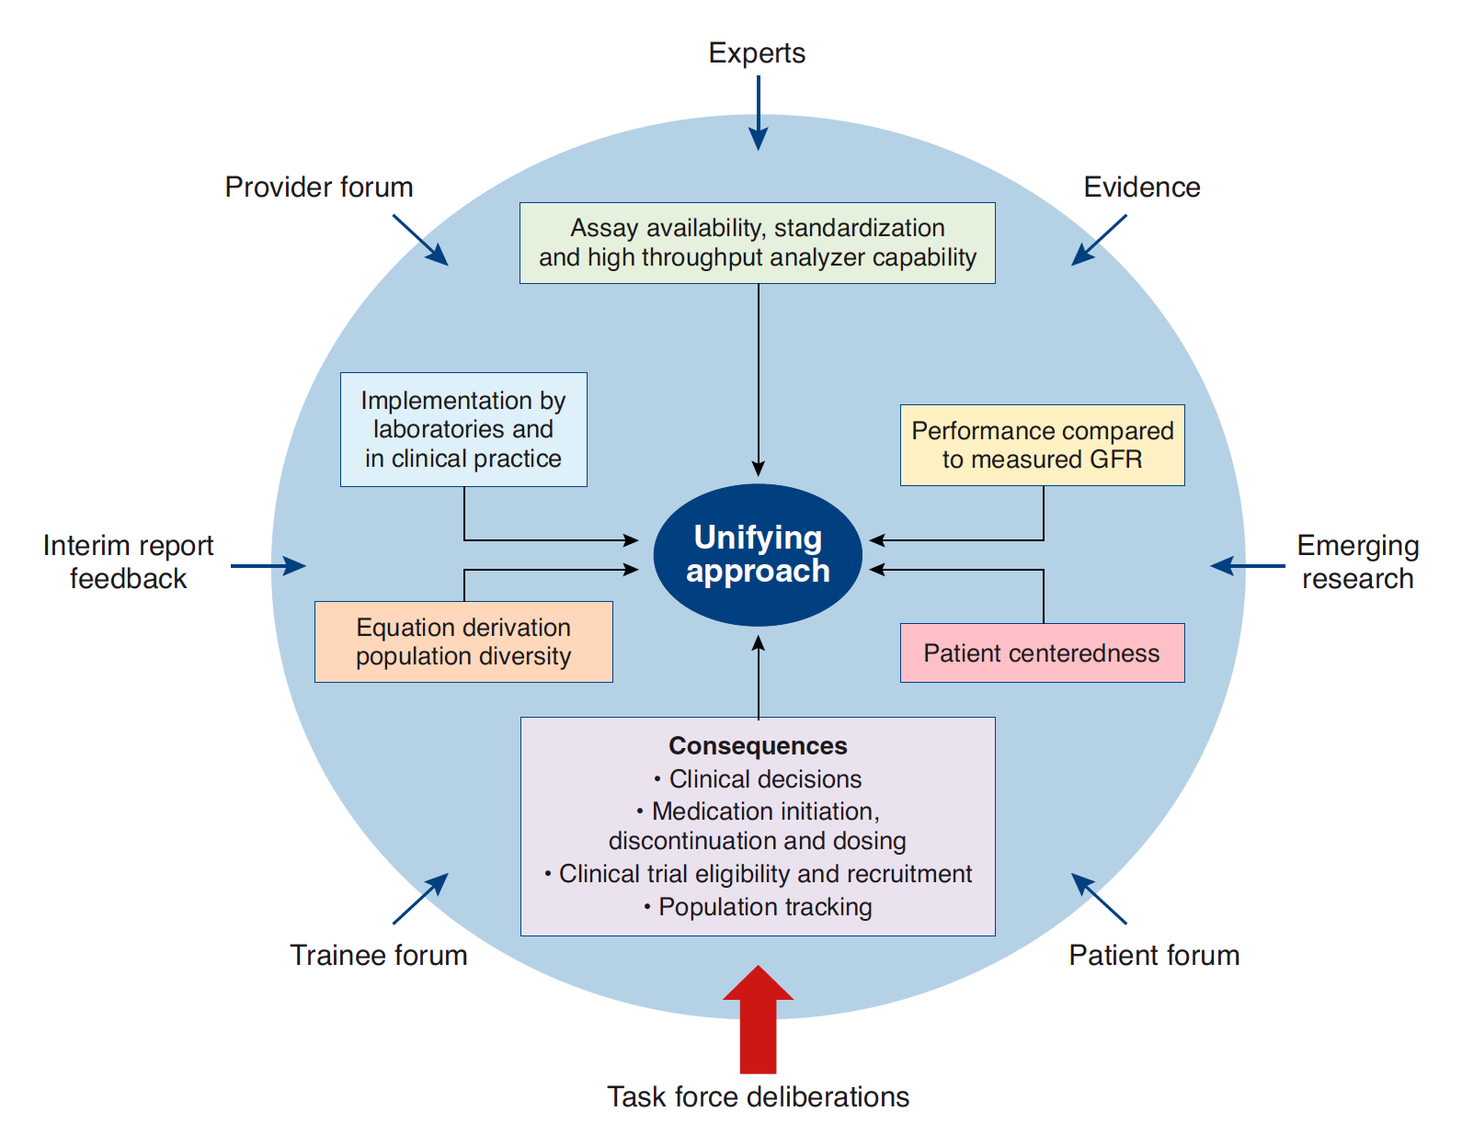
Delgado et al. JASN 2021;32:2994-3015

Slide 28
NKF-ASN TF Recommends:
Labs to report eGFRcr for adults >=18 years using the CKD-EPI 2021 refit equation that has acceptable performance characteristics and potential consequences that do not disproportionately affect any one group of individuals.

Slide 29
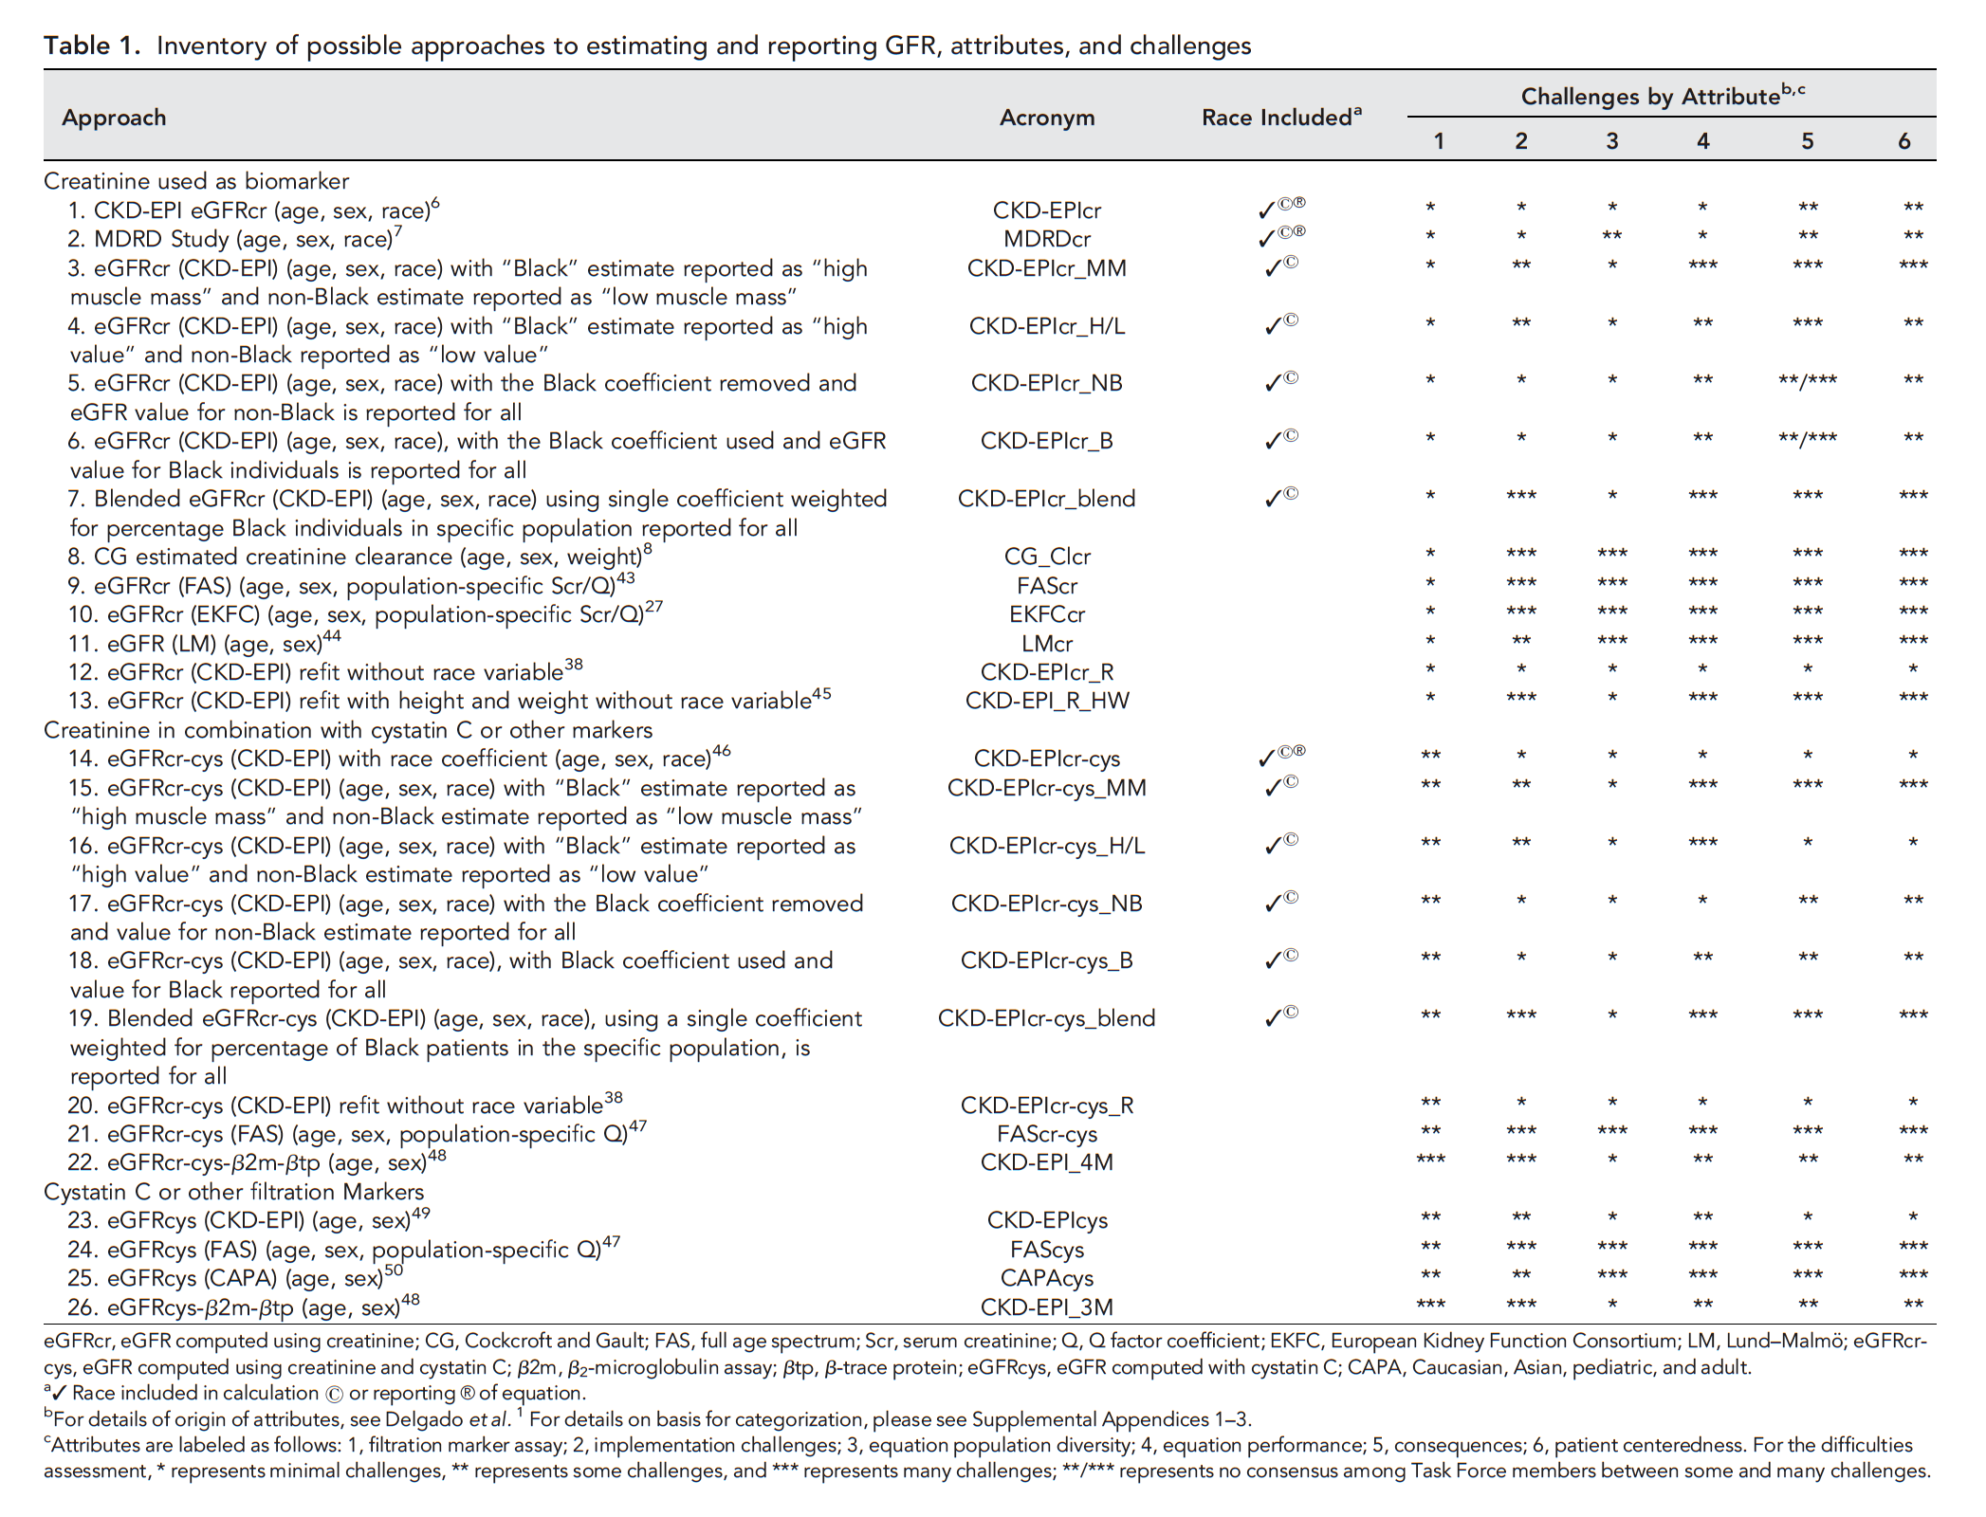

Slide 30
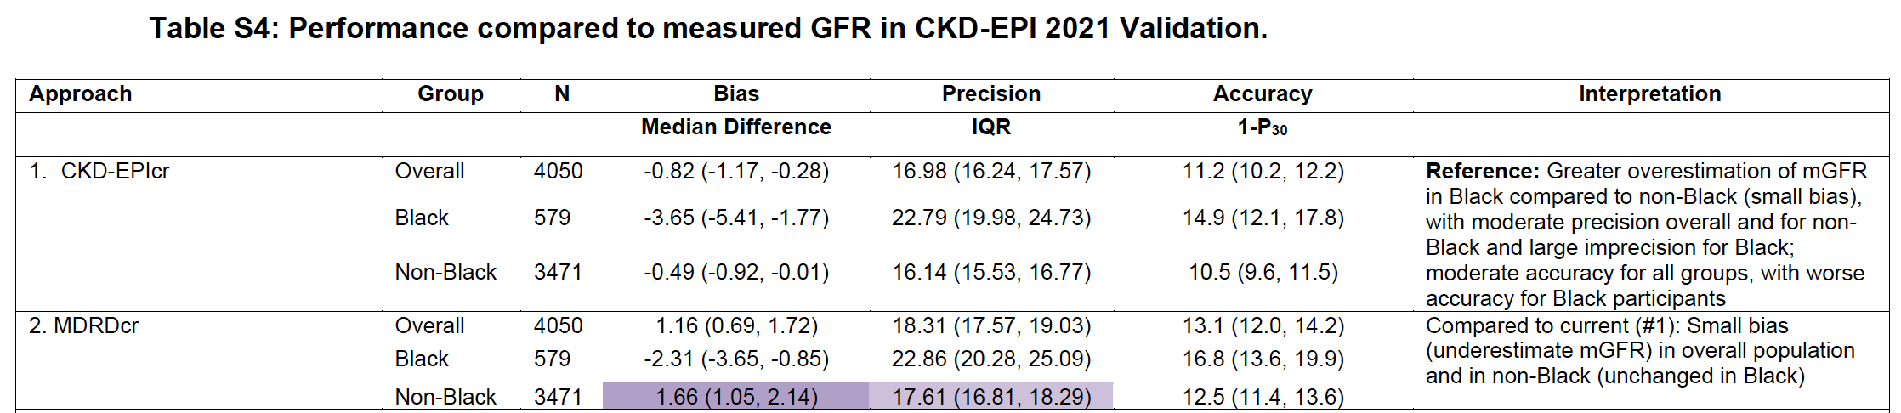
Each candidate equation was examined for performance
in all attributes
For example:
Table S4: Performance compared to measured GFR in the CKD-EPI 2021 validation data set
Continues for 26 equations
Delgado et al. JASN 2021;32:2994-3015

Slide 31
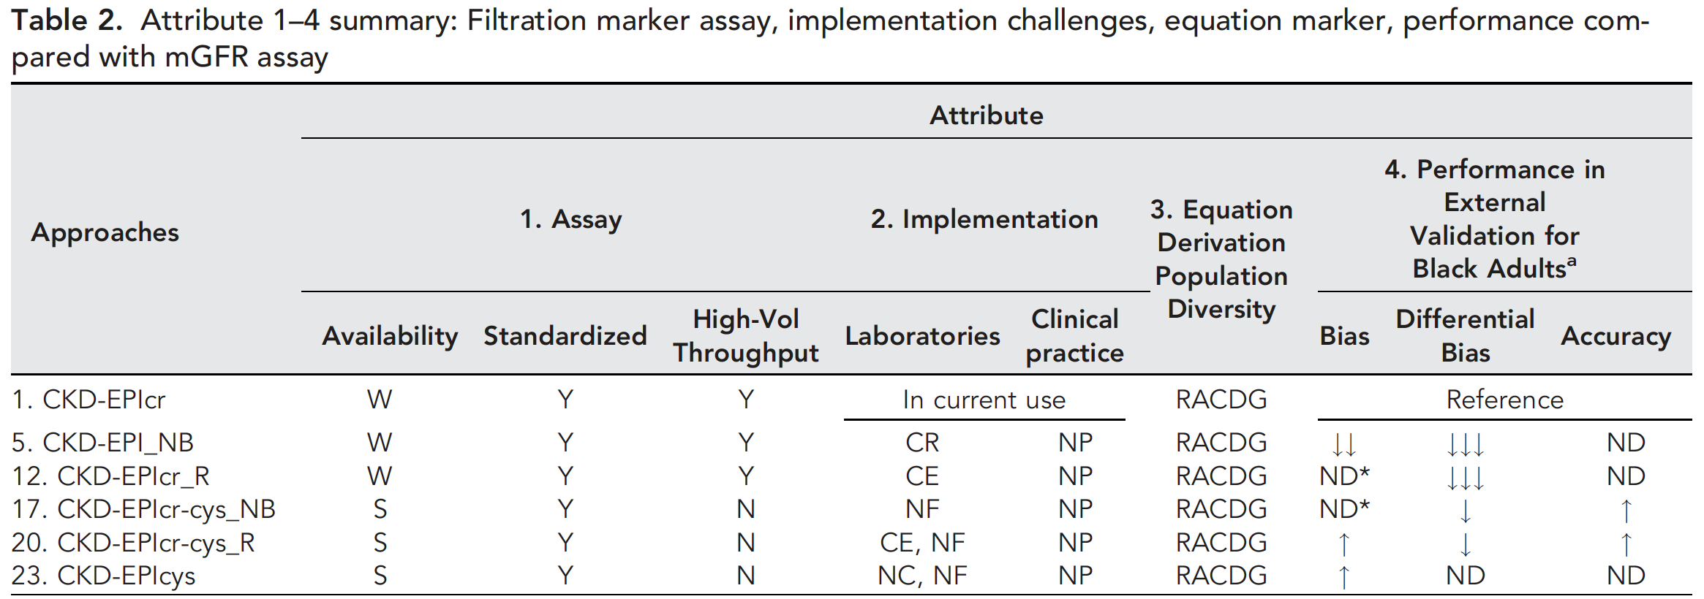
Next slide
W widespread
S specialized labs
CR change to reporting
CE change to equation
NF new filtration marker
NC no change
NP no problems anticipated
R race
A age
C CKD
D diabetes
G gender
Down arrow is worse performance
Up arrow is better performance
ND no difference
Delgado et al. JASN 2021;32:2994-3015

Slide 32
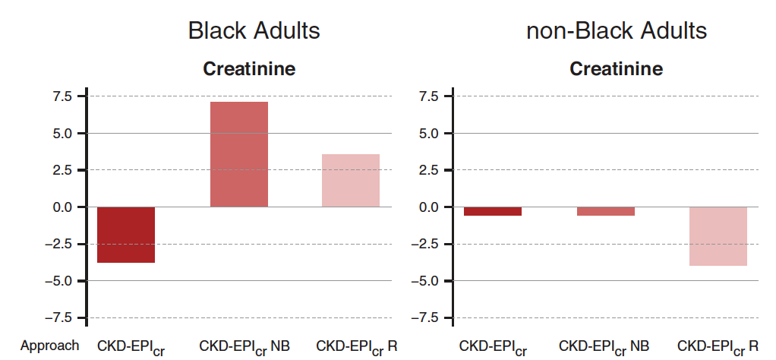
Underestimate mGFR
Bias: median diff mGFR – eGFR
mL/min/1.73m²
Overestimate mGFR
Current
Current w/o race term
Refit
Current
Current w/o race term
Refit
Delgado et al. JASN 2021;32:2994-3015

Slide 33
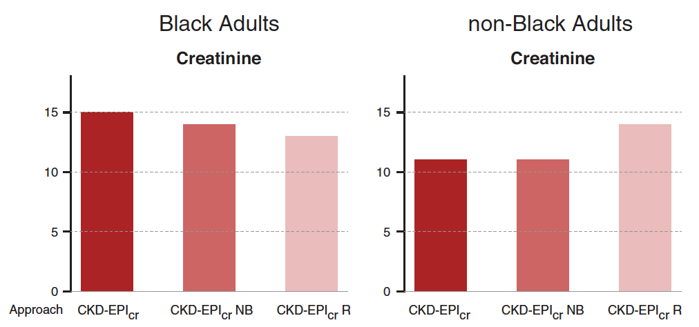
Accuracy: 1 – P30
%
Current
Current w/o race term
Refit
Current
Current w/o race term
Refit
Delgado et al. JASN 2021;32:2994-3015

Slide 34
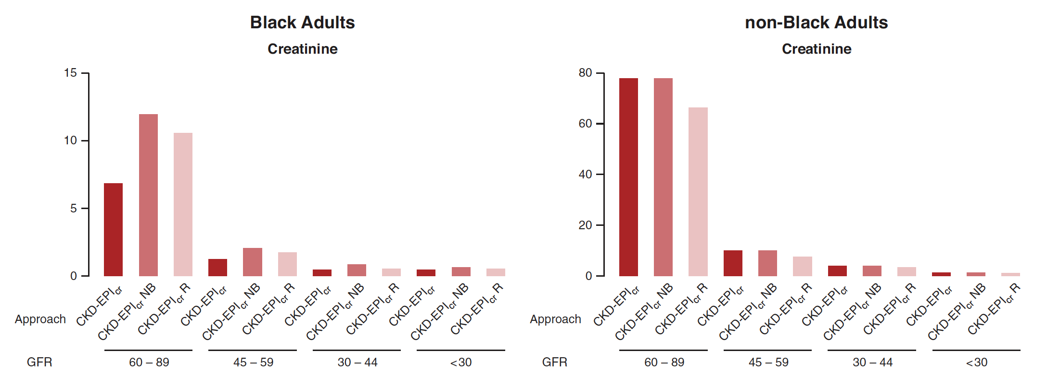
Millions of people with CKD
(NHANES 1999-2002)
refit
refit
eGFR lower so shift to lower classification
eGFR higher so shift to higher classification
Delgado et al. JASN 2021;32:2994-3015

Slide 35
NKF-ASN TF Recommends:
Labs to report eGFRcr for adults >=18 years using the CKD-EPI 2021 refit equation that has acceptable performance characteristics and potential consequences that do not disproportionately affect any one group of individuals.
National efforts to facilitate increased, routine, and timely use of cystatin C to confirm eGFR in adults who are at risk for or have CKD using the CKD-EPI 2021 refit equation for eGFRcr-cys and the CKD-EPI 2012 equation for eGFRcys.
Research on GFR estimation with new endogenous filtration markers and on interventions to eliminate race and ethnic disparities in kidney disease be encouraged and funded.

Slide 36
NKF-ASN TF Other Considerations
Clearance tests using creatinine or other markers should be used for confirmation of important clinical decisions
Wider-spread use of confirmatory tests will increase recognition of the limits of precision in GFR assessment
Labs discontinue use of serum creatinine assays that use the Jaffe reaction in favor of enzymatic assays to further limit serum creatinine variability and increase eGFR accuracy to improve standardization
Kidney disease evaluations should include an assessment for albuminuria as recommended by KDIGO

Slide 37
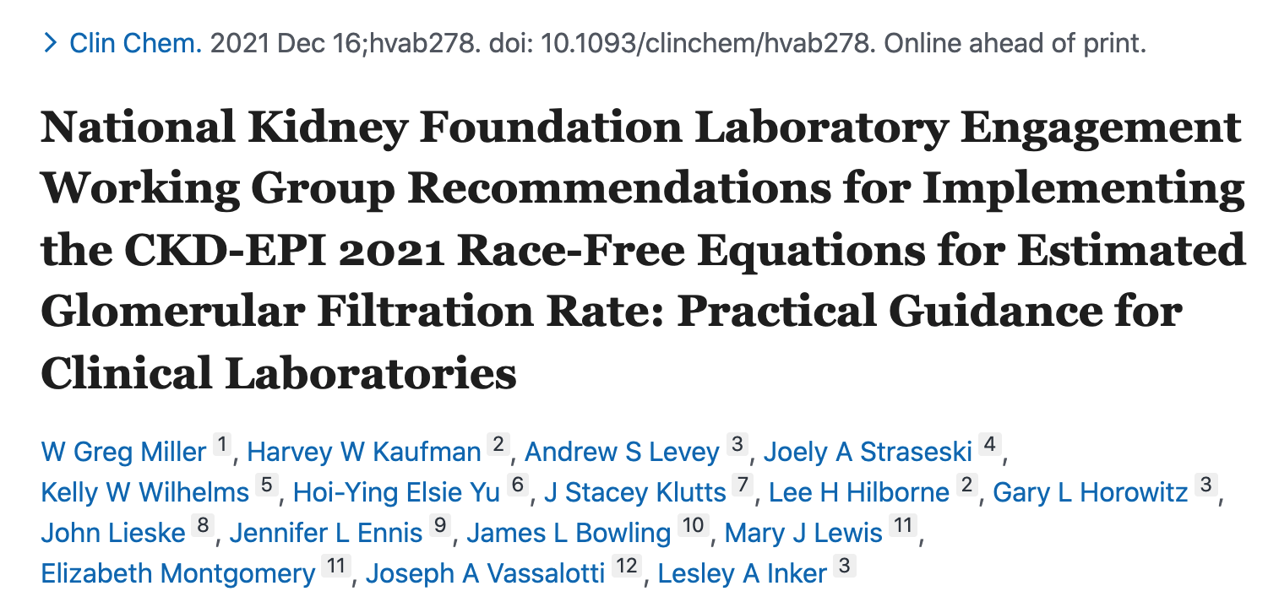

Slide 38
Labs should standardize practice
Implement the CKD-EPI 2021 equations for eGFRcr and eGFRcr-cys for adults
Use preferably enzymatic creatinine assays
Make cystatin C available in a timely manner

Slide 39
Cystatin C
When eGFRcr is 45-59 mL/min/1.73m²
eGFRcr-cys is more accurate than either alone
  Except when creatinine is compromised, use eGFRcys
    Muscle mass
    Drugs that block tubular secretion
    Unless cystatin C is compromised, use a clearance test
      Thyroid diseases
      Inflammatory diseases

Slide 40
Labs should standardize practice
Implement the CKD-EPI 2021 equations for eGFRcr and eGFRcr-cys for adults
Use preferably enzymatic creatinine assays
Make cystatin C available in a timely manner
Implement the Kidney Profile to assist providers to order both eGFRcr and urine ACR as a panel for patients with or at risk of kidney disease

Slide 41
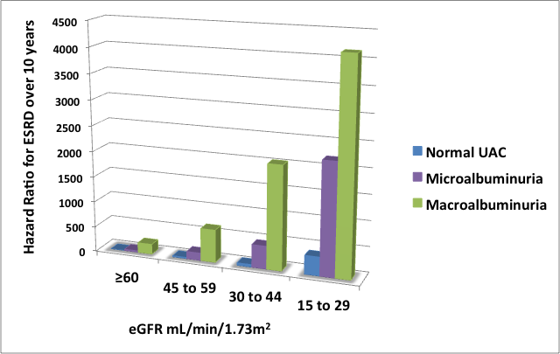
Risk for ESRD is based on eGFR and uACR
General population (Norway); N = 65,589
124 (0.2%) progressed to ESRD over 10 years
Data plotted from Hallan et al. JASN 2009;20:1069-77.
Notes:
Metaanalysis done by the Chronic Kidney Disease Consortium, established by KDIGO and tasked with compiling and analyzing the best available evidence for risk of mortality and adverse kidney outcome associated with eGFR and albuminuria. 24 studies, ACR or Dipstick total protein neg or trace, 1+ or greater than or equal to 2+
The study included >1.2 million participants, both from the general population and high risk kidney disease groups. [105,000 from 14 studies using ACR, >1million from 7 studies using urine protein dipstick.]
The data showed an increased risk for all cause mortality, cardiovascular mortality, and progression of CKD with increasing levels of albuminuria for virtually all eGFR ranges studied.
This study supports recommendations that urine albumin should be measured for risk assessment.
eGFR less than 60 and ACR > 10 are independent risk factors for mortality in the general pop (NA, europe, asia, australia). Study was included if at least 1000 participants from a general pop, ACR was preferred, but also accepted AER and pos dipstick test (neg, trace, 1+, 2+ or more). Trace dipstick was assoc with increase risk, but was less sens than ACR. >100, 000 individuals with ACR and 1.1 million indivi with dipstick results. Assoc between albuminuria and mortality was linear on a log scale.
Limitations – methods used were not standardized, some studies used frozen samples others fresh, maybe a suggestion that low eGFR had higher mort risk in AA vs. Cauc.

Slide 42
Communicate the change in eGFRcr
Collaborate with nephrologists to explain the change to
  Clinical care providers, pharmacists, nutritionists, transplant and organ donation services, researchers
  Patients who rely on their clinical providers to explain the change
Include the approximate magnitude of change in values
Educate on importance of cystatin C for follow-up
Educate on the importance of urine ACR and the Kidney Profile order
Suggested text is in the Supplemental Material

Slide 43
Communicate the magnitude of the change
Challenge is a different magnitude at different creatinine, age, sex
From the suggested wording in the Supplemental Material
  For most patients the eGFRcr result will be similar, however, for some, the values may differ by more than 10% particularly at higher values of eGFRcr and for younger adult ages.
The table in the paper is too complex

Slide 44
50 year old Male, Black
50 year old Female, non-Black

Slide 45
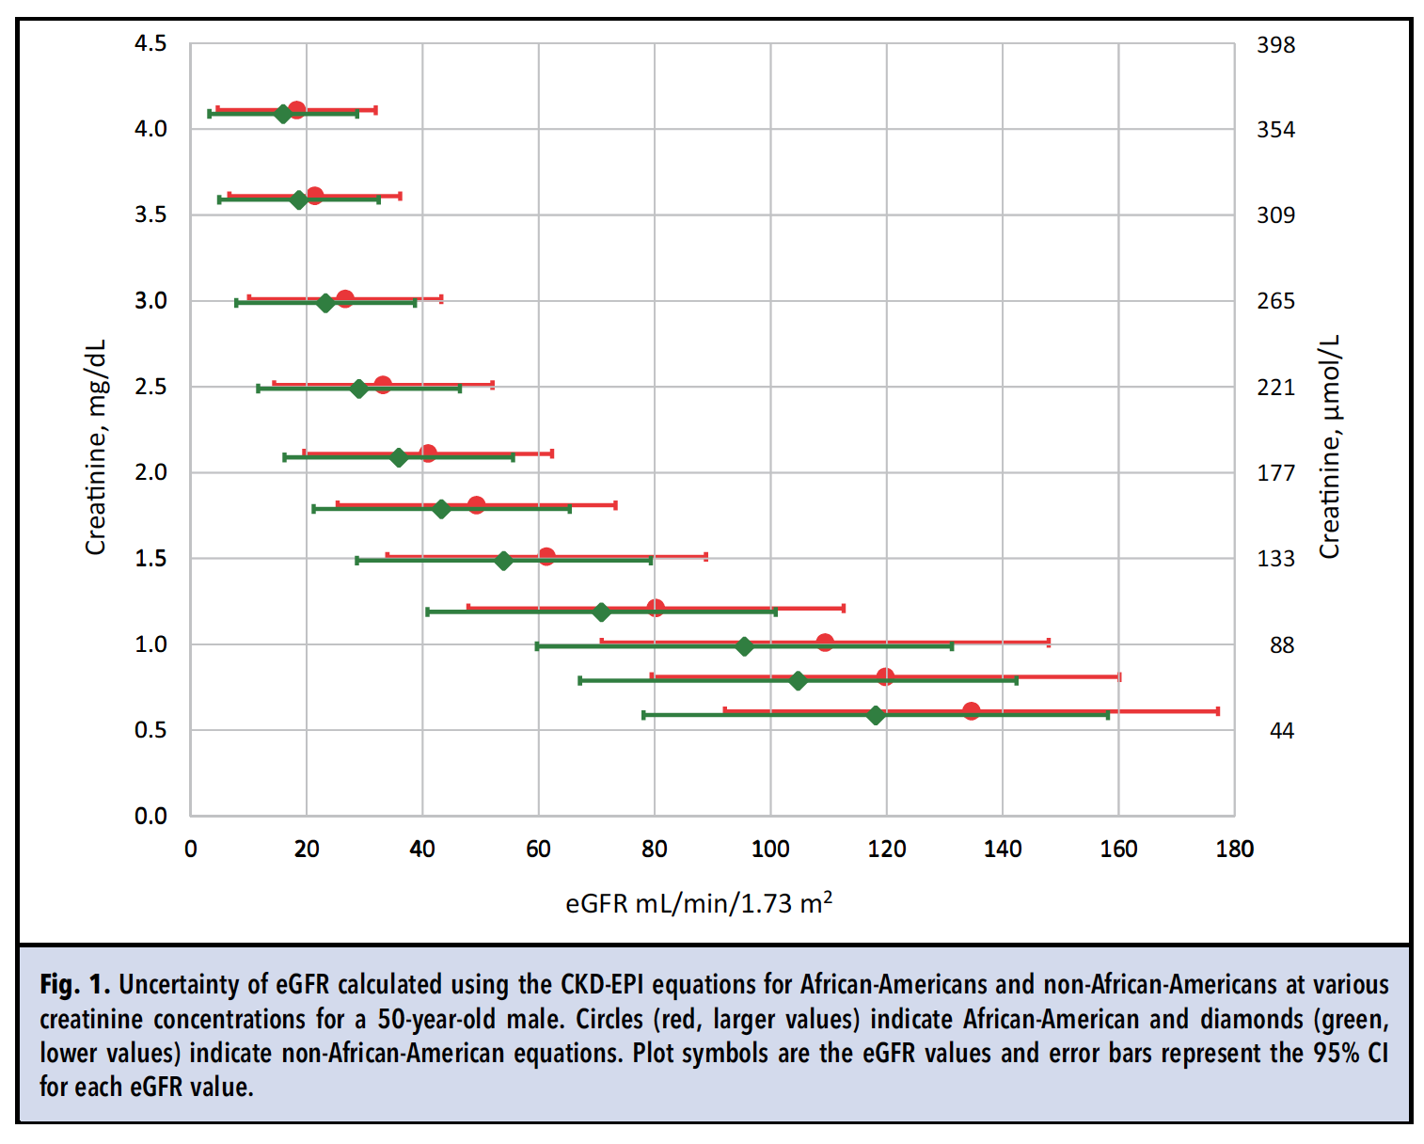
Uncertainty in eGFRcr is under-appreciated
Red is Black
Green is non-Black
U from Creatinine
w/o non-selectivity
Levey, et al. Ann Intern Med 2009; 150: 604-12.
Miller. Clin Chem 2021; 67: 693-5.

Slide 46
Programming the new equations
Same equation form with different coefficients
For example (CKD-EPI equations):
OLD, female non-Black when Scr >0.70 mg/dL:
eGFRcr = 141 x (creatinine/0.7^{)-1.209} x 0.9929^{Age} x 1.018
NEW, female when Scr >0.70 mg/dL:
eGFRcr = 142 x (creatinine/0.7^{)-1.200} x 0.9938^{Age} x 1.012

Slide 47
Programming the new equations
Tables with computational form of the equations are in the paper
Testing the new equations
Tables of test values to use to verify programming are in the Supplemental Material

Slide 48
Reporting eGFR
KDIGO recommends the terms: eGFRcr and eGFRcr-cys
New LOINC codes are available
Do not allow the new values to trend in the same row or graph with old values
Do not simultaneously report new and old values
Use units mL/min/1.73m²
Recommend single reference value of >59 or >=60 mL/min/1.73m²

Slide 49
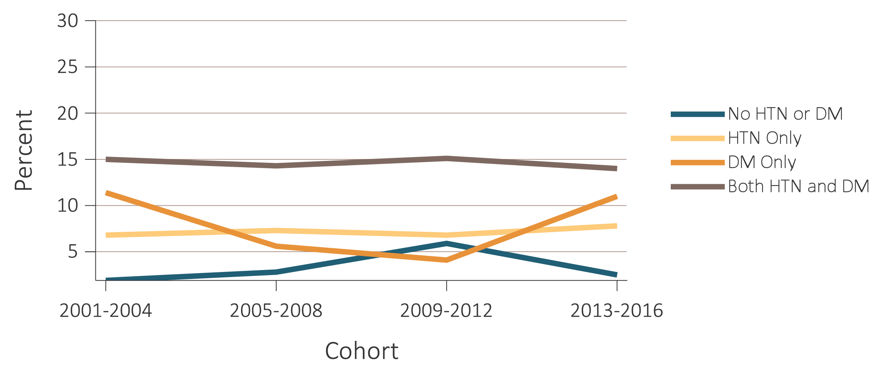

Time trends of individuals with CKD aware of their kidney disease, NHANES 2001-2016
(c) By diabetes and hypertension status
Data Source: volume 1 Figure 1.13 ; National Health and Nutrition Examination Survey (NHANES), 2001-2016 participants aged 20 & older. Abbreviations: ACR, urine albumin/creatinine ratio; CKD, chronic kidney disease; DM, diabetes mellitus; eGFR, estimated glomerular filtration rate; HTN, hypertension.

Slide 50
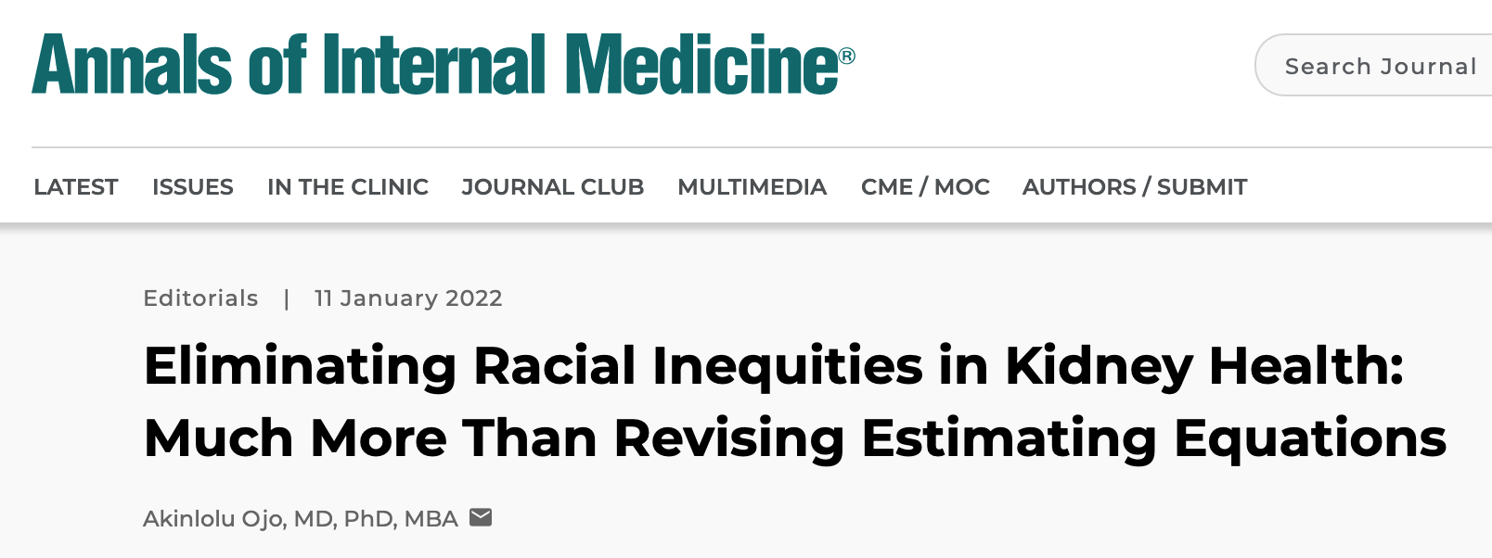
Also see:
Levey et al. CJASN 2020;15:1203-12
Eneanya et al. Nat Rev Nephrol 2022;18:84-94

Slide 51
How can the lab help
STANDARDIZE lab practice
Use the CKD-EPI 2021 equations
  Eliminates disparity associated with a race term
  Performance is marginally changed
Use enzymatic creatinine methods
Make cystatin C available in a timely manner
Offer the Kidney Profile (eGFRcr + uACR)

